Slide 1
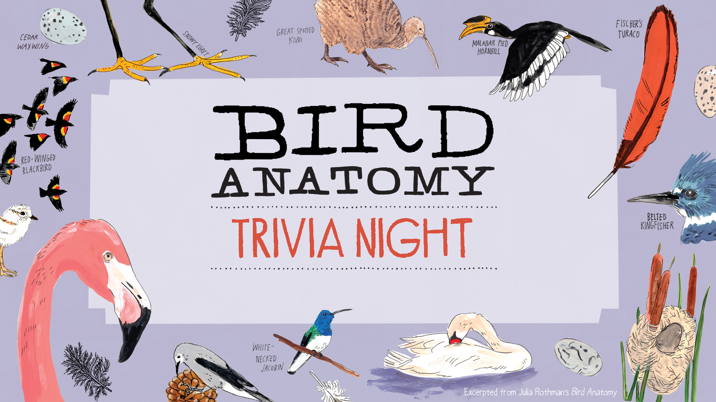
Hosted by Example Bookstore

Slide 2
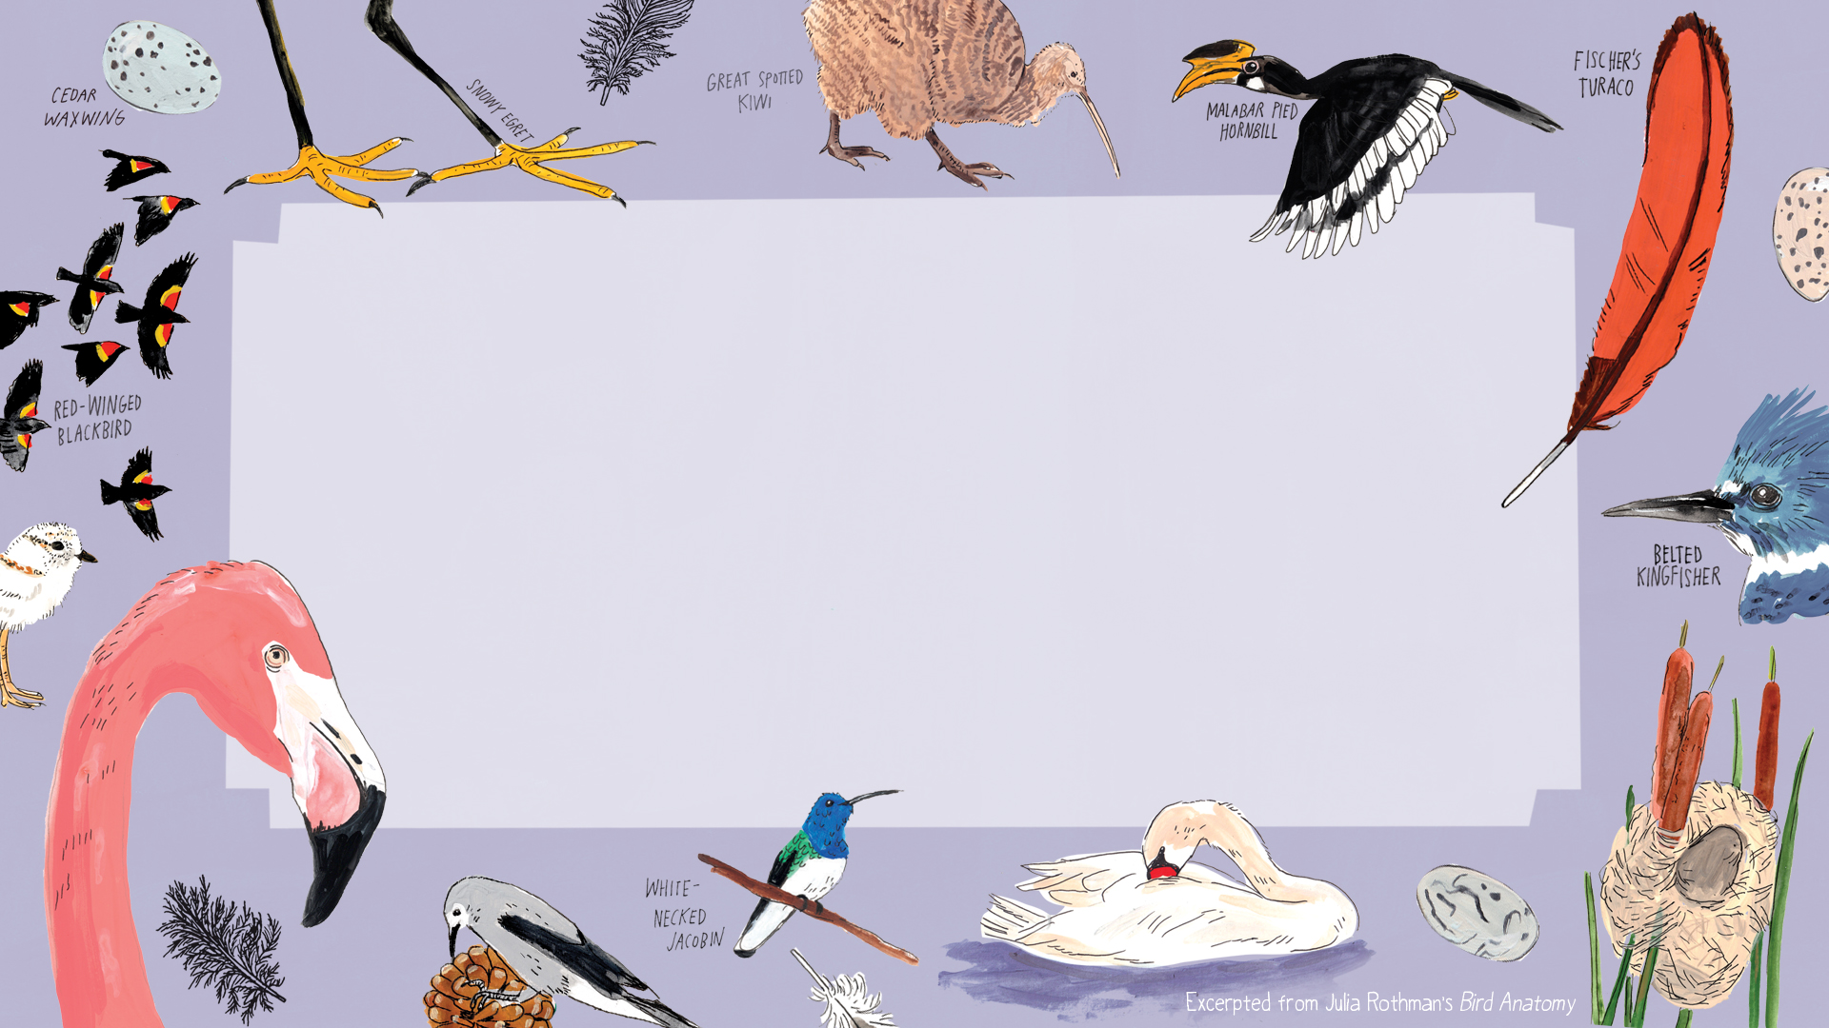
Winging It

Slide 3
This is the process of
shedding old, worn-out feathers and growing new ones

Slide 4
What kind of feather
is a rectrice? ​

Slide 5
Birds clean, realign, protect, repair and waterproof their feathers by doing this

Slide 6
Birds use these muscles to drive their wings downward

Slide 7
Name the kinds of flight (1 pt each)

Slide 8
What is the smallest bird in the world?

Slide 9
Line formations and cluster formations are two types of a group of birds. These groups are called a

Slide 10
You may know a group of geese is called a gaggle. Fill in the blank: A ____ of Jays

Slide 11
Fill in the blank: A _____ of Herons

Slide 12
This is the seasonal movement of birds between breeding and nonbreeding areas

Slide 13
Early Bird Gets the Worm

Slide 14
This type of climate is the most important habitat for birds

Slide 15
This environment has open landscapes and scattered trees or shrubs that are critical for ground-nesting birds and species that depend on seeds, insects, or small mammals

Slide 16
Birds that eat flies, beetles, moths, caterpillars and sometimes spiders are called this

Slide 17
These kinds of birds use their large, flexible lower bill to scoop up mouthfuls of fish and water, draining the water before swallowing their catch

Slide 18
A Heron’s long, slender legs and straight, pointed beak are adapted for this method of catching prey

Slide 19
This method of feeding is when birds get their food from picking it off of other plants or animals

Slide 20
This method of getting food is when birds fly low over calm water and drag their lower mandible, cutting the water’s surface and snapping up their bill when they feel a fish

Slide 21
These birds use their beaks to chisel into wood in search of insects or to carve out nest cavities for their young

Slide 22
Birds that almost exclusively hunt and feed on other animals are called this

Slide 23
According to folklore, these kinds of birds are weather forecasters – if they call from a dead branch then a clear blue sky is on its way and if it perches on a branch with green leaves and calls, then rain is expected

Slide 24
A Rare Bird

Slide 25
A bird’s _____ are typically longer, more complex vocalizations and are often used to attract
mates or defend territory

Slide 26
A bird’s _____ are shorter, simpler sounds used for everyday communication

Slide 27
Imitating the sounds of other animals (including human voices) as well as mechanical noises is called vocal _____

Slide 28
This is a collection of feathers located on top of a bird’s head and are used for communication, intimidation, attraction, and social hierarchy

Slide 29
This is the term for when males and females of the same species exhibit different physical
characteristics in size, plumage, and coloration

Slide 30
There are over 400 species of this bird that has brilliant plumage, sharp intelligence and a famous ability to mimic sounds

Slide 31
Peacocks are native to this country’s subcontinent

Slide 32
Songs, dancing, and decorating are all ways birds attempt to do this

Slide 33
A recent study found that over 80% of birds-of-paradise are biofluorescent which means they do this

Slide 34
The process of bird mating is called this

Slide 35
Feather Your Nest

Slide 36
This most common nest shape is usually made from twigs, grass and other materials
found in or on trees, shrubs, cavities, ledges and the ground

Slide 37
These kinds of nests are large and flat and are made of sticks, typically built in trees, cliffs
or human structures and are often used over many years

Slide 38
These nests are built from soil, leaves, or composting vegetation which generate heat to
incubate eggs

Slide 39
This strange behavior where birds steal hair or fur from living animals is called this

Slide 40
This family of birds create intricate, basketlike nests using grass, leaves, and plant fibers

Slide 41
This largest bird in the world lays the world’s largest eggs. Each egg can weigh up to 4 pounds which is equal to about 27 chicken eggs

Slide 42
This kind of feeding is when a bird feeds their chicks by giving them partially digested food

Slide 43
Pigeons, Flamingos, and Emperor Penguins produce a nutrient-rich substance called ____ milk

Slide 44
A bird that is almost fully feathered and ready to leave the nest is called this

Slide 45
After hatching, some birds continue to keep their young warm by covering them with their body or wings. This is called what?

